Slide 1
CS F415: Data Mining
Yashvardhan Sharma

Slide 2
Today’s Outline
Data Preprocessing
  Dimensionality Reduction
  Feature Selection and Creation
  Discretization and Binarization
  Variable Transformation

Slide 3
Dimensionality of input
Number of Observables (e.g. age and income)
If number of observables is increased
  More time to compute
  More memory to store inputs and intermediate results
  More complicated explanations (knowledge from learning)
    Regression from 100 vs. 2 parameters
  No simple visualization
    2D vs. 10D graph
  Need much more data (curse of dimensionality)

Slide 4
Dimensionality reduction
Some features (dimensions) bear little or nor useful information (e.g. color of hair for a car selection)
  Can drop some features
  Have to estimate which features can be dropped from data
Several features can be combined together without loss or even with gain of information (e.g. income of all family members for loan application)
  Some features can be combined together
  Have to estimate which features to combine from data

Slide 5
Feature Selection vs Extraction
Feature selection: Choosing k<d important features, ignoring the remaining d – k
  Subset selection algorithms
Feature extraction: Project the original x_{i} , i =1,...,d dimensions to new k<d dimensions, z_{j} , j =1,...,k
  Principal Components Analysis (PCA)
  Linear Discriminant Analysis (LDA)
  Factor Analysis (FA)

Slide 6
Usage
Have data of dimension d
Reduce dimensionality to k<d
  Discard unimportant features
  Combine several features in one
Use resulting k-dimensional data set for
  Learning for classification problem (e.g. parameters of probabilities P(x|C)
  Learning for regression problem (e.g. parameters for model y=g(x|Thetha)

Slide 7
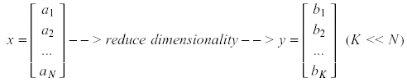
Dimensionality Reduction
Significant improvements can be achieved by first mapping the data into a lower-dimensional space.
Dimensionality can be reduced by:
  Combining features using a linear or non-linear transformations.
  Selecting a subset of features (i.e., feature selection).

Slide 8
Dimensionality Reduction (cont’d)
Linear combinations are particularly attractive because they are simple to compute and analytically tractable.
Given x ϵ R^{N}, the goal is to find an N x K matrix U such that:
y = U^{T}x ϵ R^{K} where K<<N
U^{T}

Slide 9


Dimensionality Reduction (cont’d)
Idea: represent data in terms of basis vectors in a lower dimensional space (embedded within the original space).
    (1) Higher-dimensional space representation:
    (2) Lower-dimensional sub-space representation:

Slide 10
Dimensionality Reduction (cont’d)
Classical approaches for finding an optimal linear transformation:
  Principal Components Analysis (PCA): Seeks a projection that preserves as much information in the data as possible (in a least-squares sense).
  Linear Discriminant Analysis (LDA): Seeks a projection that best separates the data (in a least-squares sense).

Slide 11
Principal Component Analysis
Given N data vectors from k-dimensions, find c ≤ k orthogonal vectors that can be best used to represent data
  The original data set is reduced to one consisting of N data vectors on c principal components (reduced dimensions)
Each data vector is a linear combination of the c principal component vectors
Works for numeric data only
Used when the number of dimensions is large

Slide 12

PCA
d-dimensional feature space
d by d symmetric covariance matrix estimated from samples
Select k largest eigenvalue of the covariance matrix and associated k eigenvectors
The first eigenvector will be a direction with largest variance

Slide 13
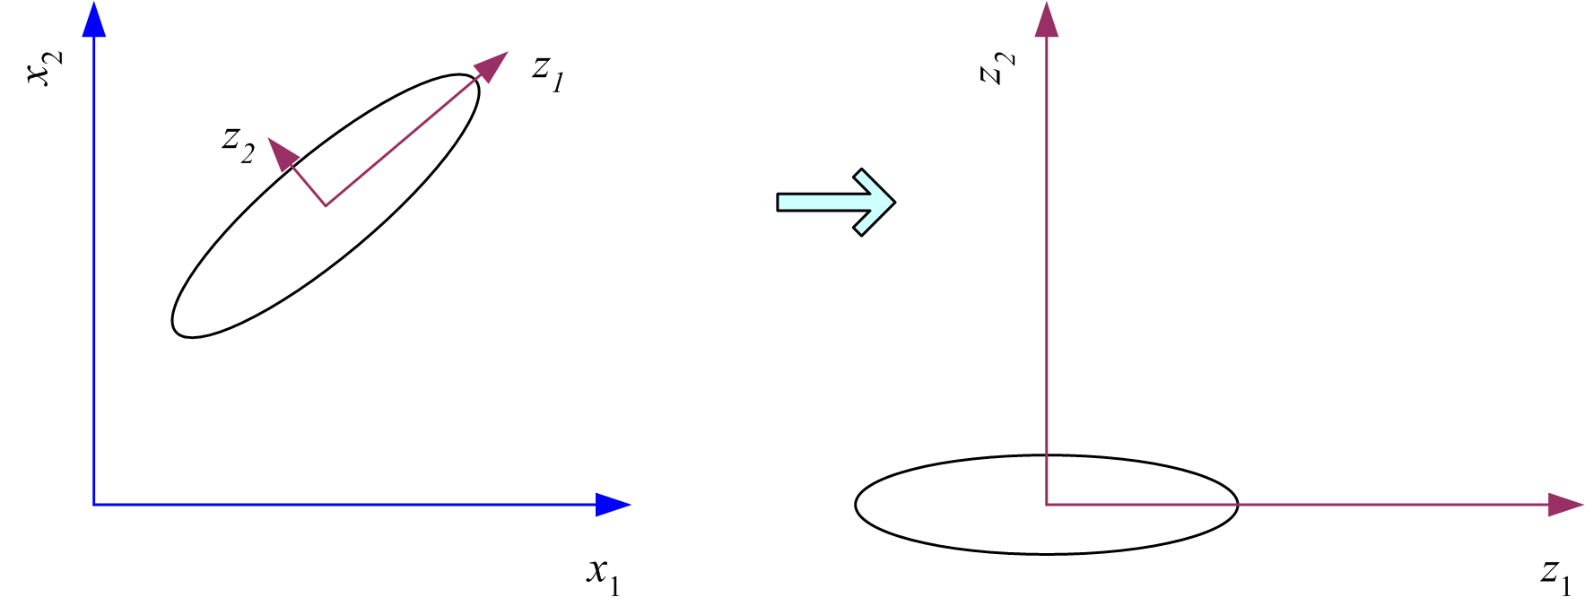
What PCA does
z = W^{T}(x – m)
where the columns of W are the eigenvectors of ∑, and m is sample mean
Centers the data at the origin and rotates the axes

Slide 14

Dimensionality Reduction: PCA
Goal is to find a projection that captures the largest amount of variation in data
Find a projection matrix w from d-dimensional to k-dimensional vectors that keeps error low
x₂
e
x₁

Slide 15
PCA: Motivation
Assume that d observables are linear combination of k<d vectors
z_{i}=w_{i1}x_{i1}+…+w_{ik}x_{id}
We would like to work with basis as it has lesser dimension and have all(almost) required information
What we expect from such basis
  Uncorrelated or otherwise can be reduced further
  Have large variance (e.g. w_{i1} have large variation) or otherwise bear no information

Slide 16
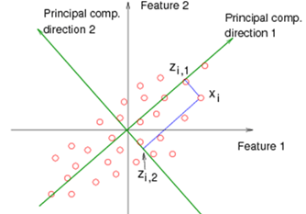
PCA: Motivation

Slide 17
PCA: Motivation
Choose directions such that a total variance of data will be maximum
  Maximize Total Variance
Choose directions that are orthogonal
  Minimize correlation
Choose k<d orthogonal directions which maximize total variance

Slide 18
Principal Component Analysis (PCA)
Dimensionality reduction implies information loss; PCA preserves as much information as possible by minimizing the reconstruction error:
How should we determine the “best” lower dimensional space?
The “best” low-dimensional space can be determined by the “best” eigenvectors of the covariance matrix of the data (i.e., the eigenvectors corresponding to the “largest” eigenvalues – also called “principal components”).

Slide 19
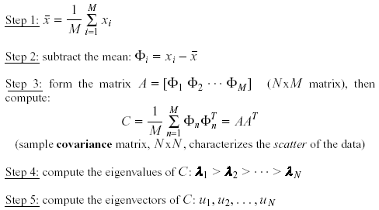
PCA - Steps
  Suppose x₁, x₂, ..., x_{M} are N x 1 vectors
(i.e., center at zero)

Slide 20
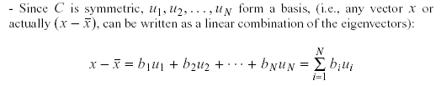

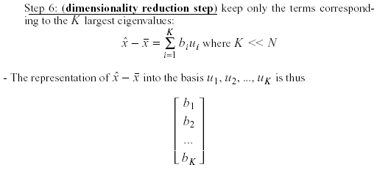
PCA – Steps (cont’d)
an orthogonal basis
where

Slide 21
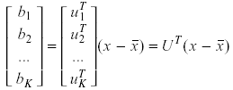
PCA – Linear Transformation
If u_{i} has unit length:
The linear transformation R^{N} → R^{K} that performs the dimensionality reduction is:

Slide 22
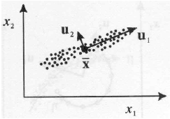
Geometric interpretation
PCA projects the data along the directions where the data varies most.
These directions are determined by the eigenvectors of the covariance matrix corresponding to the largest eigenvalues.
The magnitude of the eigenvalues corresponds to the variance of the data along the eigenvector directions.

Slide 23

How to choose K?
Choose K using the following criterion : Proportion of Variance (PoV)
In this case, we say that we “preserve” 90% or 95% of the information (variance) in the data.
If K=N, then we “preserve” 100% of the information in the data.
Scree graph plots of PoV vs k, stop at “elbow”

Slide 24
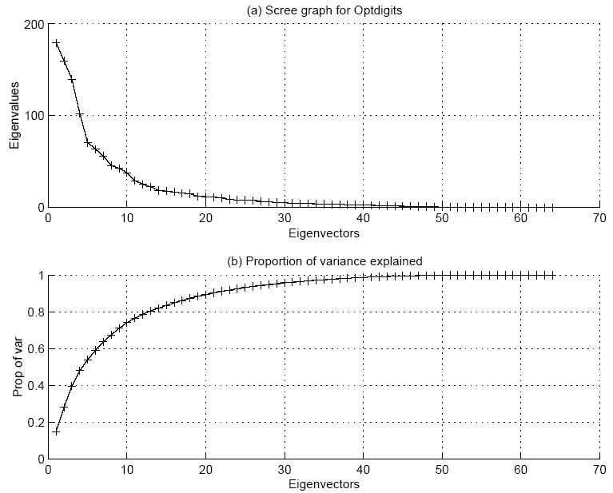

Slide 25


Error due to dimensionality reduction
The original vector x can be reconstructed using its principal components:
PCA minimizes the reconstruction error:
It can be shown that the reconstruction error is:

Slide 26

Normalization
The principal components are dependent on the units used to measure the original variables as well as on the range of values they assume.
Data should always be normalized prior to using PCA.
A common normalization method is to transform all the data to have zero mean and unit standard deviation:

Slide 27
Feature Subset Selection
Another way to reduce dimensionality of data
Redundant features
  duplicate much or all of the information contained in one or more other attributes
  Example: purchase price of a product and the amount of sales tax paid
Irrelevant features
  contain no information that is useful for the data mining task at hand
  Example: students' ID is often irrelevant to the task of predicting students' GPA

Slide 28
Subset selection
Have initial set of features of size d
There are 2^d possible subsets
Need a criteria to decide which subset is the best
A way to search over the possible subsets
Can’t go over all 2^d possibilities
Need some heuristics

Slide 29
“Goodness” of feature set
Supervised
  Train using selected subset
  Estimate error on validation data set
Unsupervised
  Look at input only(e.g. age, income and savings)
  Select subset of 2 that bear most of the information about the person

Slide 30
Dimensionality Reduction
Feature selection (i.e., attribute subset selection):
  Select a minimum set of features such that the probability distribution of different classes given the values for those features is as close as possible to the original distribution given the values of all features
  reduce # of patterns in the patterns, easier to understand
Heuristic methods (due to exponential # of choices):
  step-wise forward selection
  step-wise backward elimination
  combining forward selection and backward elimination
  decision-tree induction

Slide 31
Heuristic Feature Selection Methods
There are 2^{d} possible sub-features of d features
Several heuristic feature selection methods:
  Best single features under the feature independence assumption: choose by significance tests.
  Best step-wise feature selection:
    The best single-feature is picked first
    Then next best feature condition to the first, ...
  Step-wise feature elimination:
    Repeatedly eliminate the worst feature
  Best combined feature selection and elimination:
  Optimal branch and bound:
    Use feature elimination and backtracking

Slide 32
Feature Subset Selection
Techniques:
  Brute-force approach:
    Try all possible feature subsets as input to data mining algorithm
  Embedded approaches:
    Feature selection occurs naturally as part of the data mining algorithm
  Filter approaches:
    Features are selected before data mining algorithm is run
  Wrapper approaches:
    Use the data mining algorithm as a black box to find best subset of attributes

Slide 33
Feature Subset Selection Process

Slide 34
Feature Creation
Create new attributes that can capture the important information in a data set much more efficiently than the original attributes
Three general methodologies:
  Feature Extraction
    domain-specific
  Mapping Data to New Space
  Feature Construction
    combining features

Slide 36
Data Integration
Data integration:
  combines data from multiple sources into a coherent store
Schema integration
  integrate metadata from different sources
  Entity identification problem: identify real world entities from multiple data sources, e.g., A.cust-id ≡ B.cust-#
Detecting and resolving data value conflicts
  for the same real world entity, attribute values from different sources are different
  possible reasons: different representations, different scales, e.g., metric vs. British units

Slide 37
Handling Redundancy in Data Integration
Redundant data occur often when integration of multiple databases
  The same attribute may have different names in different databases
  One attribute may be a “derived” attribute in another table, e.g., annual revenue
Redundant data may be able to be detected by correlational analysis
Careful integration of the data from multiple sources may help reduce/avoid redundancies and inconsistencies and improve mining speed and quality

Slide 38
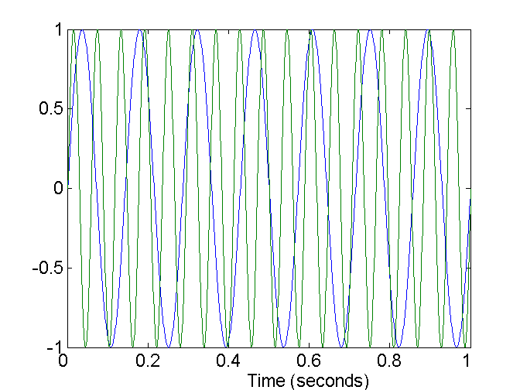
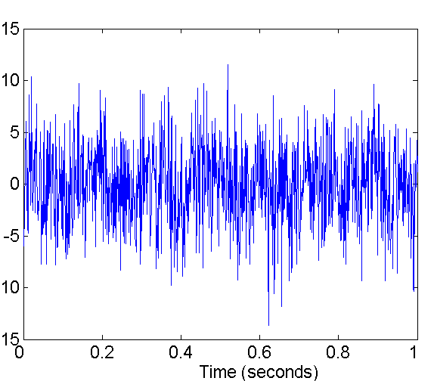
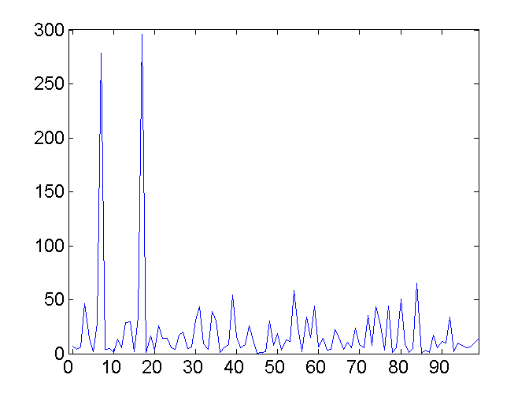
Mapping Data to a New Space
Fourier transform
Wavelet transform
Two Sine Waves
Two Sine Waves + Noise
Frequency

Slide 39
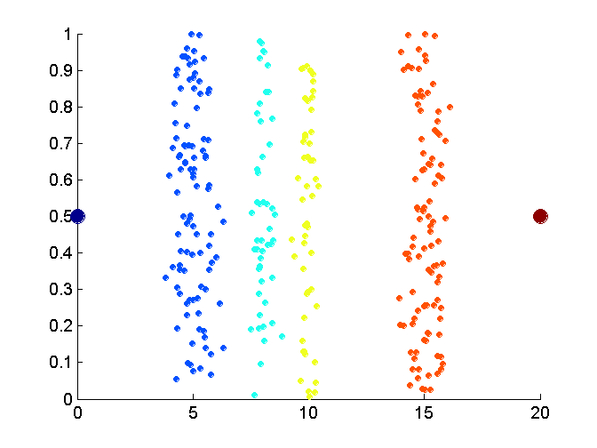
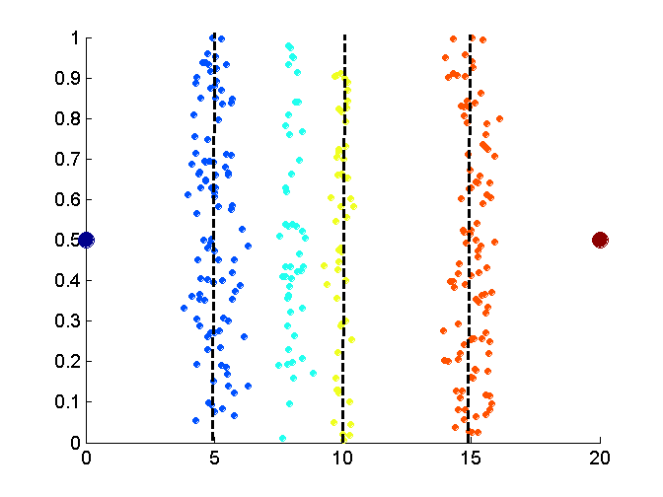
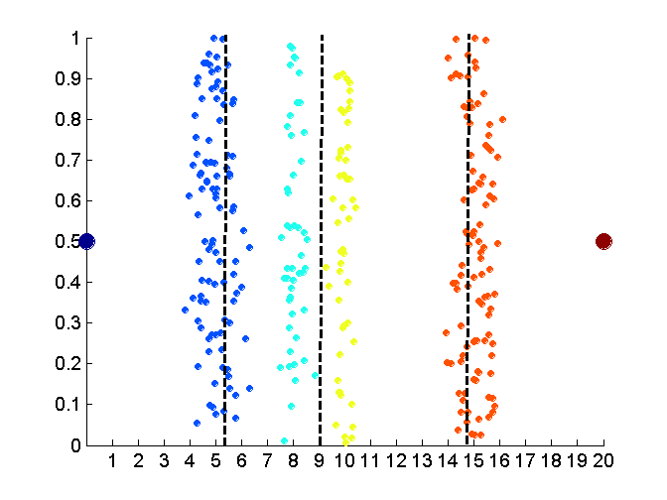
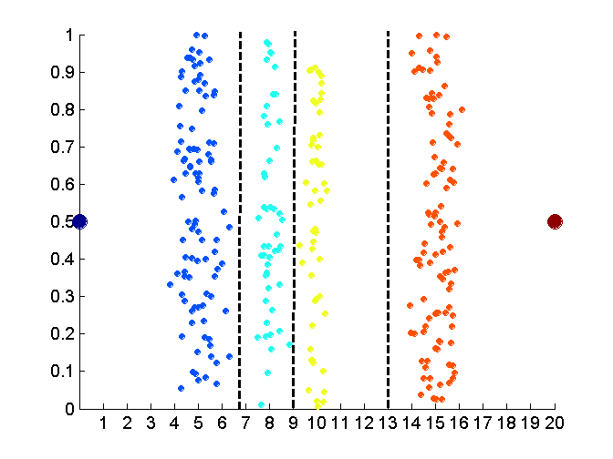
Discretization Without Using Class Labels
Data
Equal interval width
Equal frequency
K-means

Slide 40
Entropy
Formula for computing the entropy:

Slide 41
Example: fair coin throw
P (head) = 0.5
P (tail) = 0.5
Example: Coin Flip
  A_{X} = {heads, tails}
  P(heads) = P(tails) = ½
  ½ log₂(½) = ½ * - 1
  H(X) = 1

Slide 42
Example: biased coin throw
What about a two-headed coin?
Conditional Entropy:
P(head) | 0.5 | 0.25 | 0.1 | 0
P(tail) | 0.5 | 0.75 | 0.9 | 1
Entropy | 1 | 0.811 | 0.469 | 0.000

Slide 43
Entropy of a split
Information in a split with x items of one class, y items of the second class

Slide 44
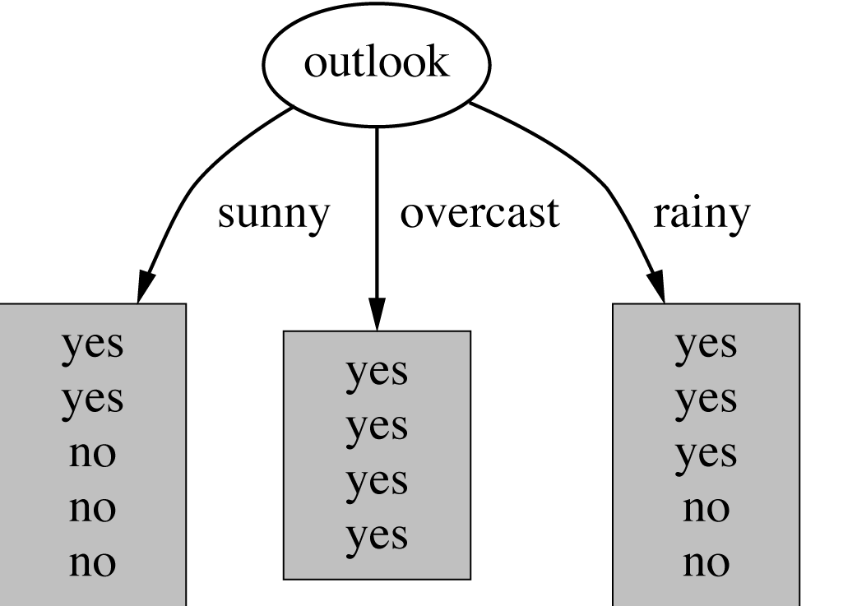
Example: attribute “Outlook”
“Outlook” = “Sunny”: 2 and 3 split

Slide 45
Outlook = Overcast
“Outlook” = “Overcast”: 4/0 split
Note: log(0) is not defined, but we evaluate 0*log(0) as zero

Slide 46
Outlook = Rainy
“Outlook” = “Rainy”:

Slide 47
Expected Information
Expected information for attribute:

Slide 48
Computing the information gain
Information gain:
(information before split) – (information after split)
Information gain for attributes from weather data:

Slide 49
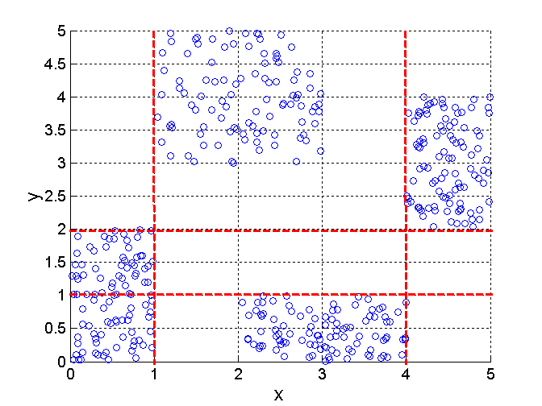
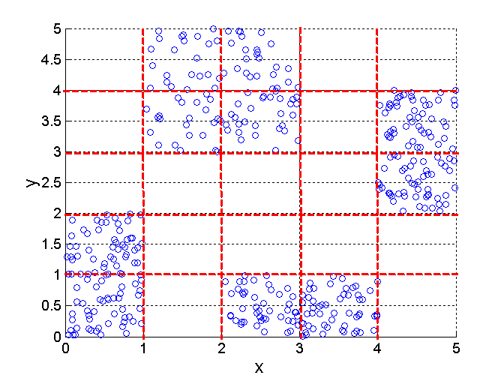
Discretization Using Class Labels
Entropy based approach
3 categories for both x and y
5 categories for both x and y

Slide 50
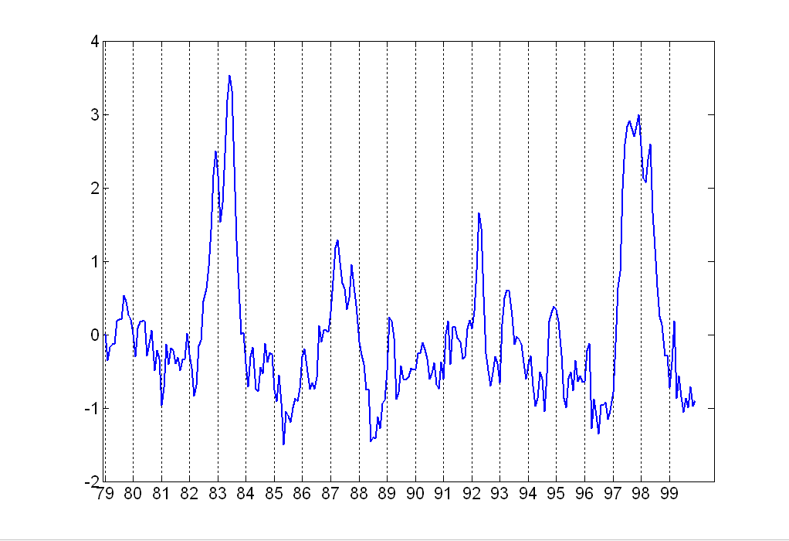
Attribute Transformation
A function that maps the entire set of values of a given attribute to a new set of replacement values such that each old value can be identified with one of the new values
  Simple functions: x^{k}, log(x), e^{x}, |x|
  Standardization and Normalization

Slide 51
Numerosity Reduction
Parametric methods
  Assume the data fits some model, estimate model parameters, store only the parameters, and discard the data (except possible outliers)
  Log-linear models: obtain value at a point in m-D space as the product on appropriate marginal subspaces
Non-parametric methods
  Do not assume models
  Major families: histograms, clustering, sampling

Slide 52
Regression and Log-Linear Models
Linear regression: Data are modeled to fit a straight line
  Often uses the least-square method to fit the line
Multiple regression: allows a response variable Y to be modeled as a linear function of multidimensional feature vector
Log-linear model: approximates discrete multidimensional probability distributions

Slide 53
Regress Analysis and Log-Linear Models
Linear regression: Y = α + β X
  Two parameters , α and β specify the line and are to be estimated by using the data at hand.
  using the least squares criterion to the known values of Y1, Y2, …, X1, X2, ….
Multiple regression: Y = b0 + b1 X1 + b2 X2.
  Many nonlinear functions can be transformed into the above.
Log-linear models:
  The multi-way table of joint probabilities is approximated by a product of lower-order tables.
  Probability: p(a, b, c, d) = αab βacχad δbcd

Slide 54
Histograms
A popular data reduction technique
Divide data into buckets and store average (sum) for each bucket
Can be constructed optimally in one dimension using dynamic programming
Related to quantization problems.

Slide 55
Clustering
Partition data set into clusters, and one can store cluster representation only
Can be very effective if data is clustered but not if data is “smeared”
Can have hierarchical clustering and be stored in multi-dimensional index tree structures
There are many choices of clustering definitions and clustering algorithms, further detailed in Chapter 8

Slide 56
Data Compression
String compression
  There are extensive theories and well-tuned algorithms
  Typically lossless
  But only limited manipulation is possible without expansion
Audio/video compression
  Typically lossy compression, with progressive refinement
  Sometimes small fragments of signal can be reconstructed without reconstructing the whole
Time sequence is not audio
  Typically short and vary slowly with time

Slide 57
Data Compression
Original Data
Compressed
Data
lossless
Original Data
Approximated
lossy

Slide 58
Wavelet Transformation
Haar2
Daubechie4
Discrete wavelet transform (DWT): linear signal processing, multiresolutional analysis
Compressed approximation: store only a small fraction of the strongest of the wavelet coefficients
Similar to discrete Fourier transform (DFT), but better lossy compression, localized in space
Method:
  Length, L, must be an integer power of 2 (padding with 0s, when necessary)
  Each transform has 2 functions: smoothing, difference
  Applies to pairs of data, resulting in two set of data of length L/2
  Applies two functions recursively, until reaches the desired length

Slide 59
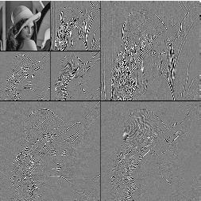
DWT for Image Compression
Image
Low Pass High Pass
Low Pass High Pass
Low Pass High Pass

Slide 60
Discretization
Three types of attributes:
  Nominal — values from an unordered set
  Ordinal — values from an ordered set
  Continuous — real numbers
Discretization:
  divide the range of a continuous attribute into intervals
  Some classification algorithms only accept categorical attributes.
  Reduce data size by discretization
  Prepare for further analysis

Slide 61
Discretization and Concept hierachy
Discretization
  reduce the number of values for a given continuous attribute by dividing the range of the attribute into intervals. Interval labels can then be used to replace actual data values
Concept hierarchies
  reduce the data by collecting and replacing low level concepts (such as numeric values for the attribute age) by higher level concepts (such as young, middle-aged, or senior)

Slide 62
Concept Hierarchy Generation for Categorical Data
Specification of a partial ordering of attributes explicitly at the schema level by users or experts
  street<city<state<country
Specification of a portion of a hierarchy by explicit data grouping
  {Urbana, Champaign, Chicago}<Illinois
Specification of a set of attributes.
  System automatically generates partial ordering by analysis of the number of distinct values
  E.g., street < city <state < country
Specification of only a partial set of attributes
  E.g., only street < city, not others

Slide 63
Automatic Concept Hierarchy Generation
Some concept hierarchies can be automatically generated based on the analysis of the number of distinct values per attribute in the given data set
  The attribute with the most distinct values is placed at the lowest level of the hierarchy
  Note: Exception—weekday, month, quarter, year
country
15 distinct values
province_or_ state
65 distinct values
city
3567 distinct values
street
674,339 distinct values

Slide 64
Similarity and Dissimilarity
Similarity
  Numerical measure of how alike two data objects are.
  Is higher when objects are more alike.
  Often falls in the range [0,1]
Dissimilarity
  Numerical measure of how different are two data objects
  Lower when objects are more alike
  Minimum dissimilarity is often 0
  Upper limit varies
Proximity refers to a similarity or dissimilarity

Slide 65
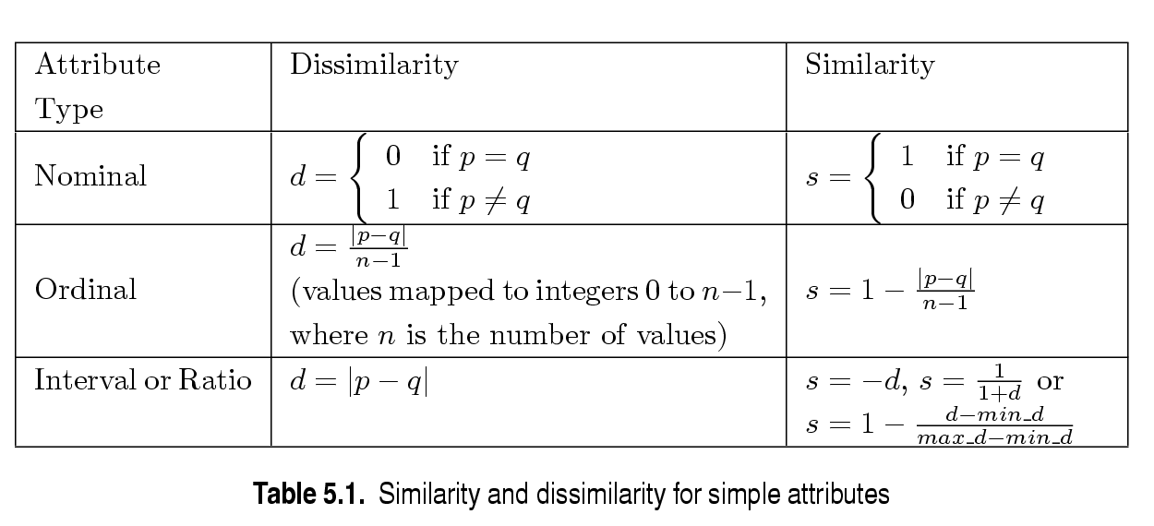
Similarity/Dissimilarity for Simple Attributes
p and q are the attribute values for two data objects.

Slide 66
Euclidean Distance
Euclidean Distance
  Where n is the number of dimensions (attributes) and p_{k} and q_{k} are, respectively, the k^{th} attributes (components) or data objects p and q.
Standardization is necessary, if scales differ.

Slide 67
Euclidean Distance
Distance Matrix

Slide 68
Minkowski Distance
Minkowski Distance is a generalization of Euclidean Distance
  Where r is a parameter, n is the number of dimensions (attributes) and p_{k} and q_{k} are, respectively, the kth attributes (components) or data objects p and q.

Slide 69
Minkowski Distance: Examples
r = 1. City block (Manhattan, taxicab, L₁ norm) distance.
  A common example of this is the Hamming distance, which is just the number of bits that are different between two binary vectors
r = 2. Euclidean distance
r → ∞. “supremum” (L_{max} norm, L∞ norm) distance.
  This is the maximum difference between any component of the vectors
Do not confuse r with n, i.e., all these distances are defined for all numbers of dimensions.

Slide 70
Minkowski Distance
Distance Matrix

Slide 71
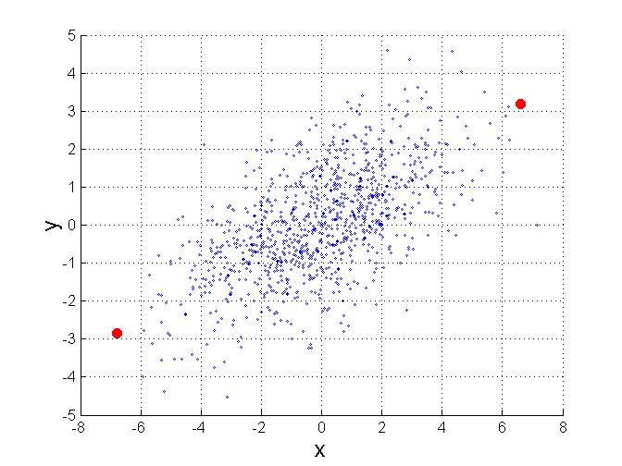
Mahalanobis Distance
Σ is the covariance matrix of the input data X
For red points, the Euclidean distance is 14.7, Mahalanobis distance is 6.

Slide 72
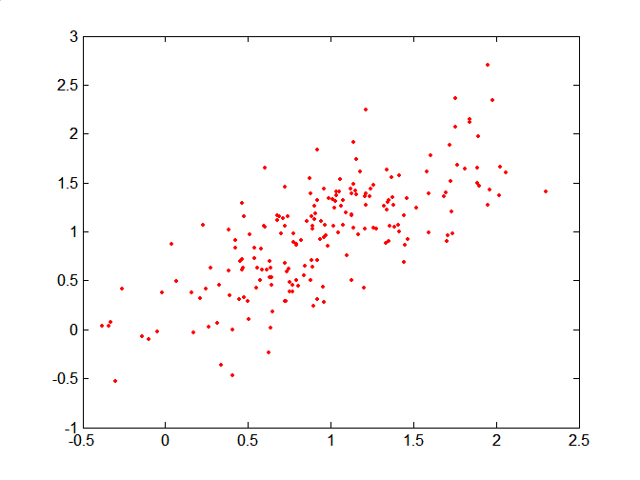
Mahalanobis Distance
Covariance Matrix:
C
B
A: (0.5, 0.5)
B: (0, 1)
C: (1.5, 1.5)
Mahal(A,B) = 5
Mahal(A,C) = 4
A

Slide 73
Common Properties of a Distance
Distances, such as the Euclidean distance, have some well known properties.
  d(p, q) ≥ 0 for all p and q and d(p, q) = 0 only if
  p = q. (Positive definiteness)
  d(p, q) = d(q, p) for all p and q. (Symmetry)
  d(p, r) ≤ d(p, q) + d(q, r) for all points p, q, and r.
  (Triangle Inequality)
where d(p, q) is the distance (dissimilarity) between points (data objects), p and q.
A distance that satisfies these properties is a metric

Slide 74
Common Properties of a Similarity
Similarities, also have some well known properties.
  s(p, q) = 1 (or maximum similarity) only if p = q.
  s(p, q) = s(q, p) for all p and q. (Symmetry)
where s(p, q) is the similarity between points (data objects), p and q.

Slide 75
Similarity Between Binary Vectors
Common situation is that objects, p and q, have only binary attributes
Compute similarities using the following quantities
M₀₁ = the number of attributes where p was 0 and q was 1
M₁₀ = the number of attributes where p was 1 and q was 0
M₀₀ = the number of attributes where p was 0 and q was 0
M₁₁ = the number of attributes where p was 1 and q was 1
Simple Matching and Jaccard Coefficients
SMC = number of matches / number of attributes
= (M₁₁ + M₀₀) / (M₀₁ + M₁₀ + M₁₁ + M₀₀)
J = number of 11 matches / number of not-both-zero attributes values
= (M₁₁) / (M₀₁ + M₁₀ + M₁₁)

Slide 76
SMC versus Jaccard: Example
p = 1 0 0 0 0 0 0 0 0 0
q = 0 0 0 0 0 0 1 0 0 1
M₀₁ = 2 (the number of attributes where p was 0 and q was 1)
M₁₀ = 1 (the number of attributes where p was 1 and q was 0)
M₀₀ = 7 (the number of attributes where p was 0 and q was 0)
M₁₁ = 0 (the number of attributes where p was 1 and q was 1)
SMC = (M₁₁ + M₀₀)/(M₀₁ + M₁₀ + M₁₁ + M₀₀) = (0+7) / (2+1+0+7) = 0.7
J = (M₁₁) / (M₀₁ + M₁₀ + M₁₁) = 0 / (2 + 1 + 0) = 0

Slide 77
Cosine Similarity
If d₁ and d₂ are two document vectors, then
cos( d₁, d₂ ) = (d₁ • d₂) / ||d₁|| ||d₂|| ,
where • indicates vector dot product and || d || is the length of vector d.
Example:
d₁ = 3 2 0 5 0 0 0 2 0 0
d₂ = 1 0 0 0 0 0 0 1 0 2
d₁ • d₂= 3*1 + 2*0 + 0*0 + 5*0 + 0*0 + 0*0 + 0*0 + 2*1 + 0*0 + 0*2 = 5
||d₁|| = (3*3+2*2+0*0+5*5+0*0+0*0+0*0+2*2+0*0+0*0)^{0.5} = (42) ^{0.5} = 6.481
||d₂|| = (1*1+0*0+0*0+0*0+0*0+0*0+0*0+1*1+0*0+2*2) ^{0.5} = (6) ^{0.5} = 2.245
cos( d₁, d₂ ) = .3150

Slide 78
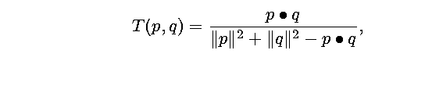
Extended Jaccard Coefficient (Tanimoto)
Variation of Jaccard for continuous or count attributes
  Reduces to Jaccard for binary attributes

Slide 79
Correlation
Correlation measures the linear relationship between objects
To compute correlation, we standardize data objects, p and q, and then take their dot product

Slide 80
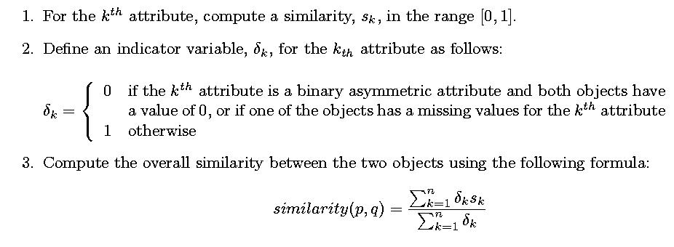
General Approach for Combining Similarities
Sometimes attributes are of many different types, but an overall similarity is needed.

